Slide 1

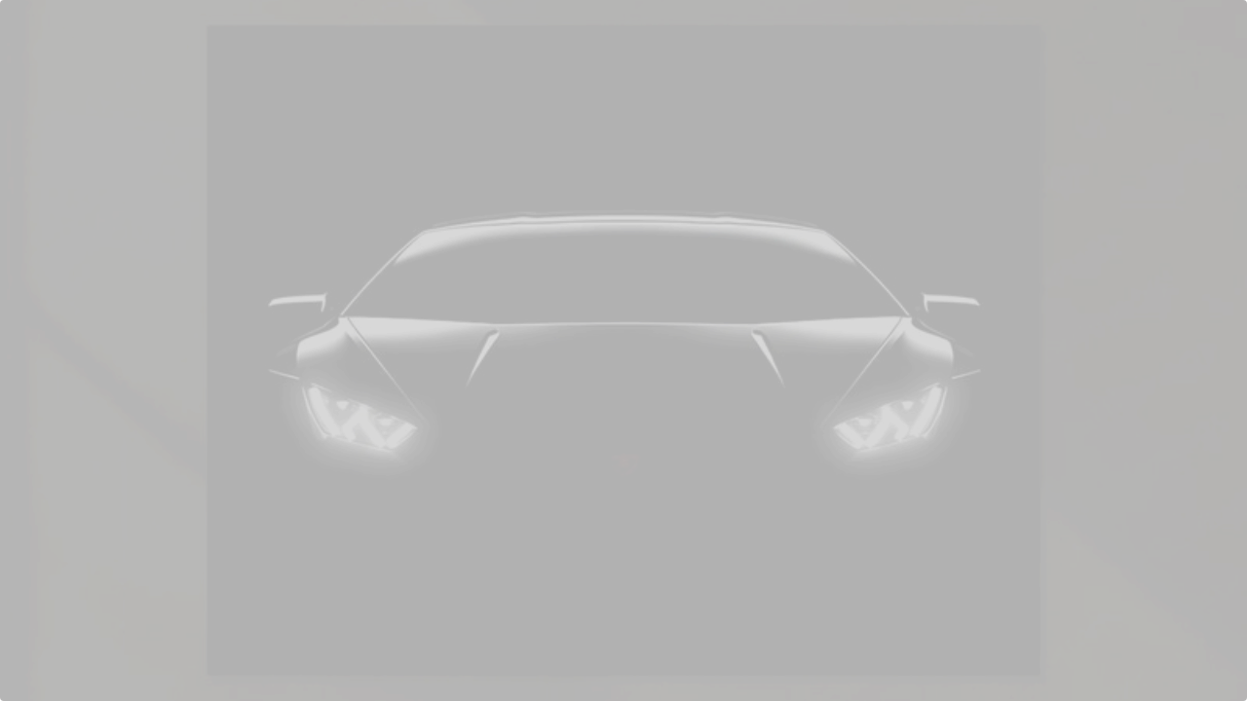

ENGINE TALK
PERFORMANCE • PRESTIGE • POWER
Krishna | Chaitanya Bansal
AUTOMOTIVE WEB PLATFORM

Slide 2




01 / PROBLEM STATEMENT
NO CENTRAL HUB
STATIC EXPERIENCE
Luxury car enthusiasts lacked a single, premium destination to browse brands, performance specs, and high-res visuals in one immersive interface.
Most existing sites lacked real-time interactivity. Users couldn't visualize car colors live or manage persistent carts without backend accounts.

Slide 3





02 / PROJECT OBJECTIVES
PREMIUM SHOWCASE
DYNAMIC FILTERING
INTERACTIVE GARAGE
Clean, high-performance website for exotic luxury vehicles.
Instant sorting by brand, horsepower, or type via JS.
Real-time color configurator and live spec explorer.

Slide 4
03 / USER JOURNEY
LOGIN
SHOWROOM
GARAGE
SELECTION
CHECKOUT
Secure entry
Browse heroes
Configure
Full catalog
Finalize

Slide 5

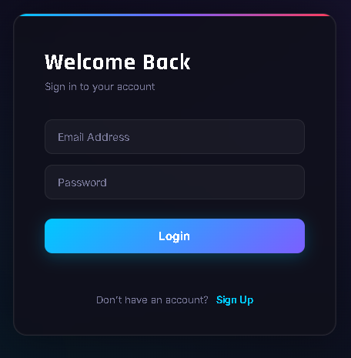
P1 / LOGIN & REGISTRATION
SECURE ACCESS NODE
◈
LocalStorage-based credential storage
◈
Real-time form validation & neon feedback
◈
Persistent session across refreshes
◈
Sleek Dark UI with animated focus states
◈
Auto-redirect for authenticated users

Slide 6
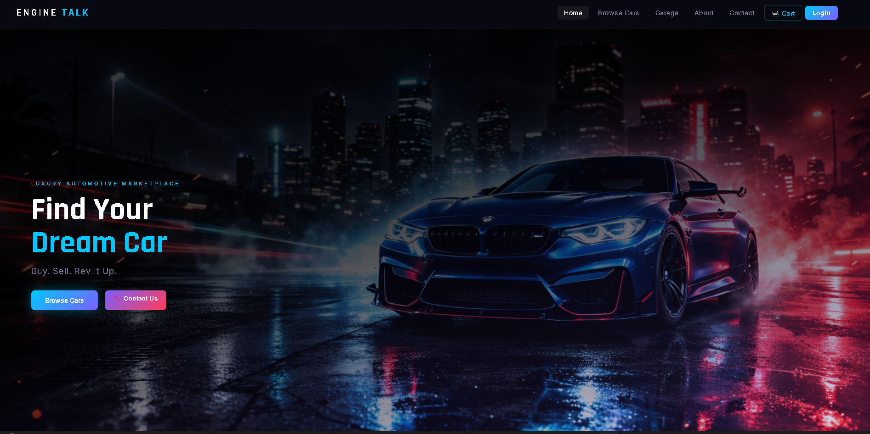
P2 / SHOWROOM EXPERIENCE
THE HOMEPAGE
◈
Full-screen hero section with animated tagline entrance
◈
Featured Cars grid with curated top performance models
◈
Sticky navigation with cart count badge

Slide 7
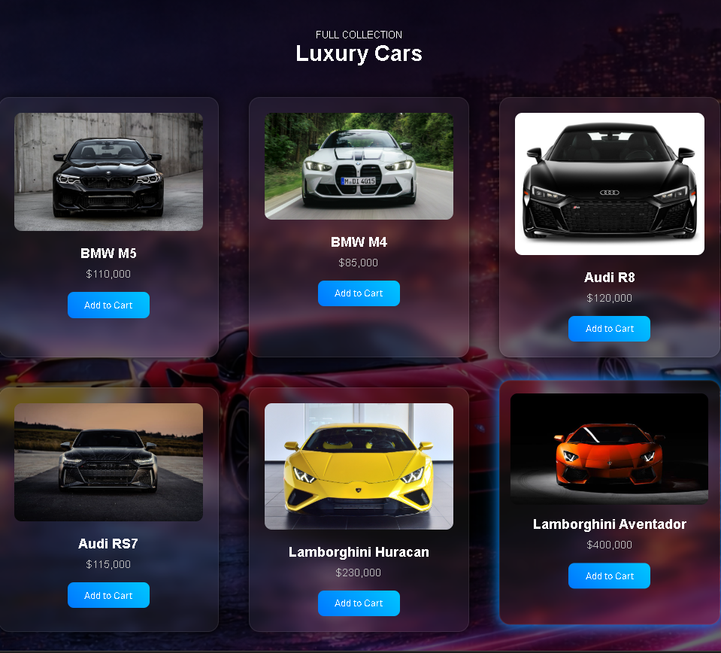
P3 / DISCOVERY ENGINE
INTELLIGENT CATALOG
A high-fidelity grid featuring 12 exotic models with real-time DOM filtering.
◈
Multi-criteria filtering: Brand, Type, HP
◈
No-reload instant UI re-renders
◈
Responsive grid (3-col to 1-col mobile)
◈
Detailed car cards with live pricing

Slide 8
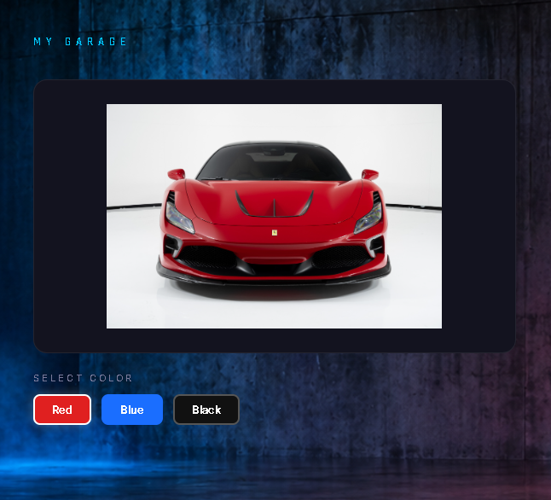
P4 / INTERACTIVE GARAGE
REAL-TIME PERSONALIZATION
◈
Flagship brands: Porsche, Ferrari, McLaren
◈
3 custom paint colors with live previews
◈
Async fade transitions for smooth swapping
◈
Dynamic spec panel updates on-the-fly
◈
Direct "Add to Garage" cart integration

Slide 9
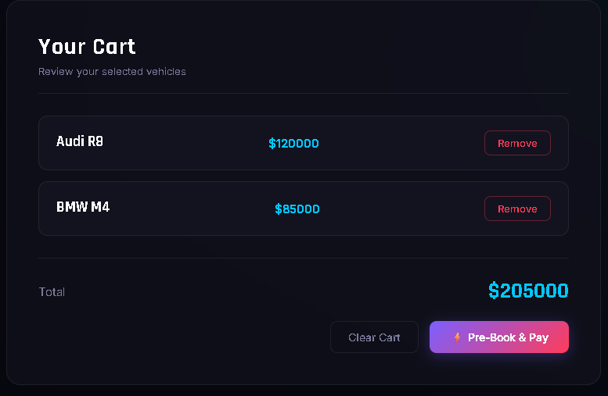
P5 / CART MANAGEMENT
MY GARAGE SELECTION
A transparent staging area where users review their tailored builds before checking out.
◈
Persistent Summary: Syncs configured car details, selected paint finishes, and custom specs.
◈
Live Total Matrix: Instant multi-item price addition calculations directly inside the DOM.
◈
Frictionless Pruning: Dynamic item removals with low-latency smooth layout transitions.

Slide 10
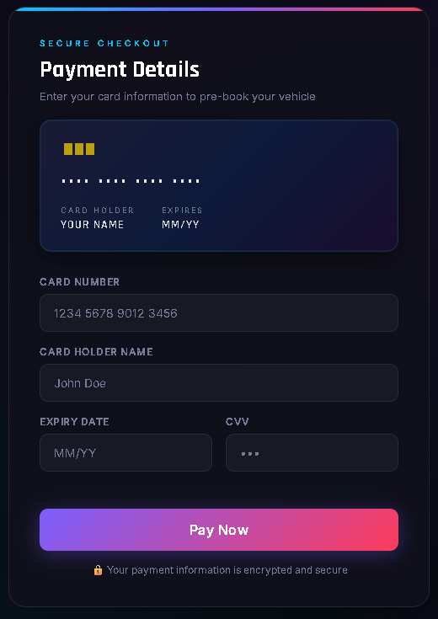

P6 / PREMIUM PAYMENT UI
Frictionless Transactions
A secure checkout flow designed for high-trust premium automotive acquisitions.
◈
Cart validated globally via 'et_cart' state string
◈
Interactive layout matching premium payment styles
◈
Neon error alerts on blank or malformed input
◈
Automated success gateway landing mechanics

Slide 11

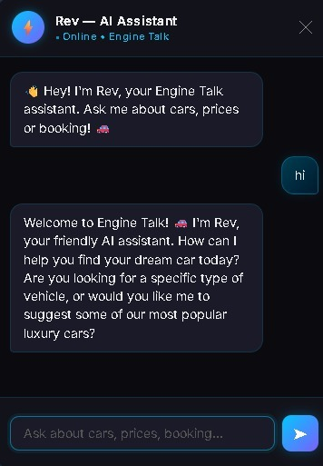
P7 / AI CONCIERGE
Intelligent API Integration
Engine Talk now features a sophisticated AI Chatbot powered by state-of-the-art Large Language Models to assist users throughout their journey.
◈
Expert Support: Instant answers to technical specifications and model availability.
◈
Personalized Discovery: Suggests exotic vehicles based on unique performance profiles.
◈
Seamless Handover: Direct connection to specialist support for bespoke acquisitions.

Slide 12

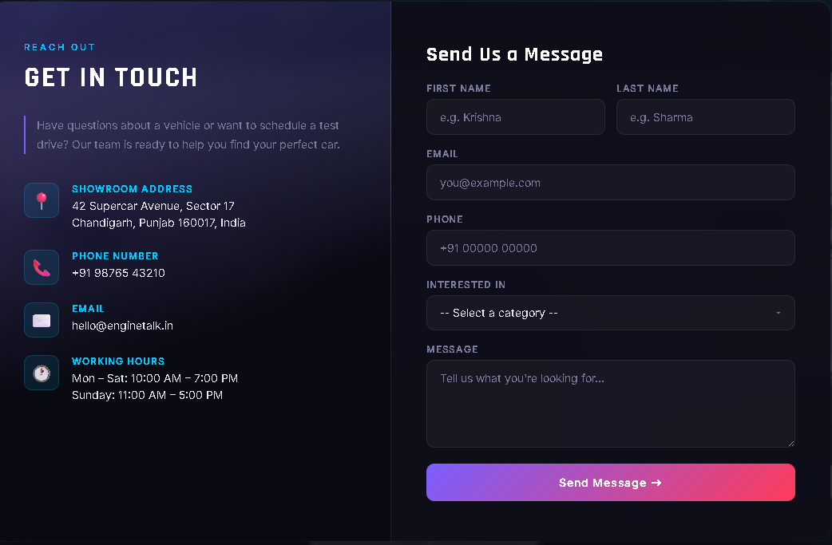
P8 / CONTACT US
ELITE SUPPORT
Connect with the Engine Talk specialists for bespoke acquisitions and technical inquiries. Our team is available 24/7 for our premium members.
support@enginetalk.auto
+1 (800) LUX-AUTO
Silicon Valley, CA

Slide 13
05 / CHALLENGES & RESOLUTIONS
Challenge | Resolution Strategy | Outcome
Data Persistence | Unified LocalStorage key 'et_cart' | Serverless session continuity
Dynamic Swapping | JS Async fade transitions | Seamless 300ms rendering
Neon UI Fidelity | Media-query optimized CSS filters | Low-latency visual consistency

Slide 14


06 / FUTURE ROADMAP
05
STRATEGIC EXPANSION
Responsive Pages
◈
Phase 2: Backend - Node.js & MongoDB integration.
◈
Phase 3: Analytics - Dashboard for conversion metrics.
12
◈
Phase 4: 3D Viewer - WebGL interactive model viewer.
Exotic Models

Slide 15


THANK YOU
KRISHNA
CHAITANYA BANSAL
ROLL NUMBER: 2510992866
ROLL NUMBER: 2510992870
BE CSE with AI & ML | Semester II
BE CSE with AI & ML | Semester II

